Slide 1

A Proposed Geospatial Decision Making Framework For Immediate Aid
“A GEOSPATIAL SOLUTION FOR HUMANITARIAN ASSISTANCES”
A GIS BASED PLANNING, IMPLEMENTATION, MAINTAINANCE AND AWARENESS FOR IMMEDIATE AID
SNEHA MANOHARAN,
MAIL ID:manosneha067@gmail.com
4th YEAR B.TECH,
GEOTECHNOLOGY AND GEOINFORMATICS,
DEPARTMENT OF REMOTE SENSING,
BHARATHIDASAN UNIVERSITY,
THIRUCHIRAPPALLI, TAMILNADU, INDIA.

Slide 2
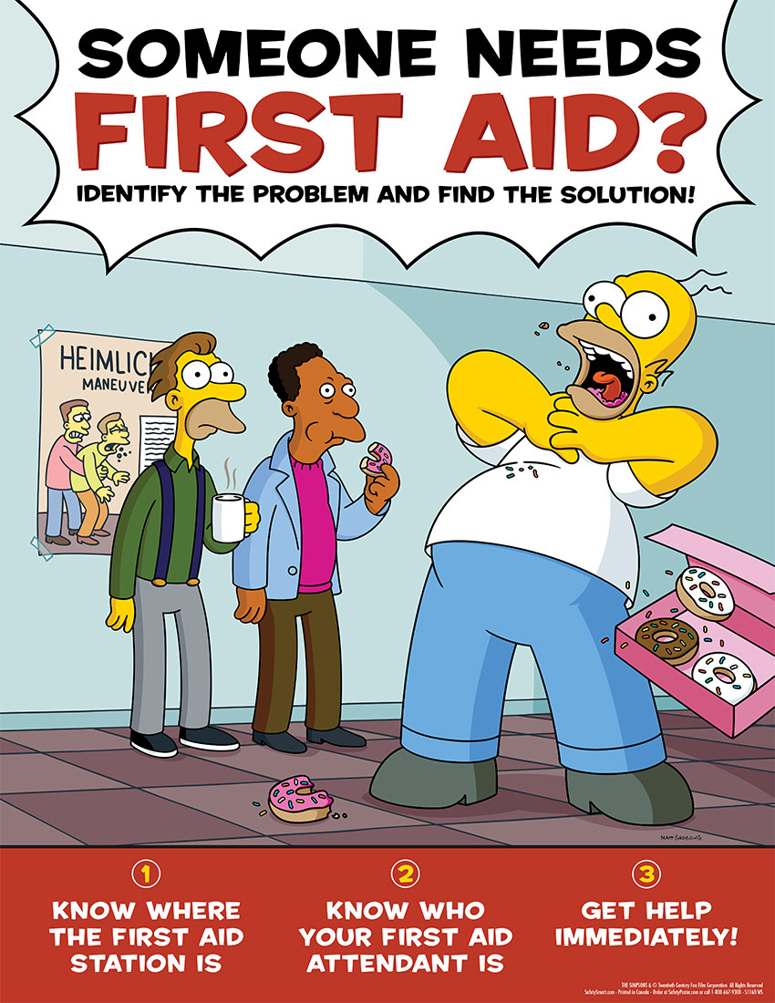
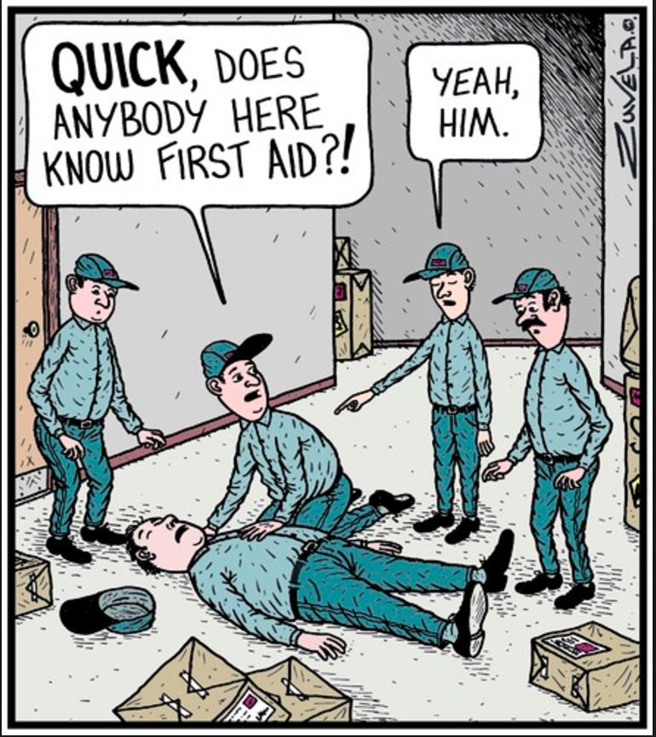
BACKGROUND

Slide 3

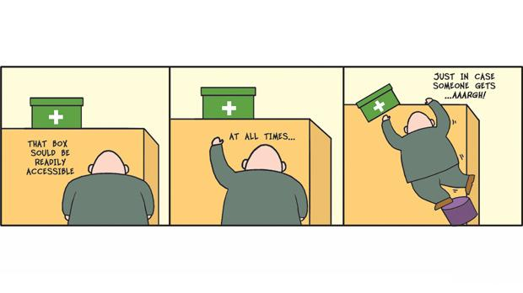

Slide 4
ANALYSIS OF EXISTING SITUATION
ACCORDING TO “WHO” DEATH REPORTED IN INDIA ONLY IN ROAD ACCIDENT
On an average per day there are 290 deaths happens on road accidents in India now a days.
YEAR | DEATH RATE
2016 | 1,46,133
2017 | 2,18,876
2018 | 1,51,417
2019 | 1,54,732

Slide 5
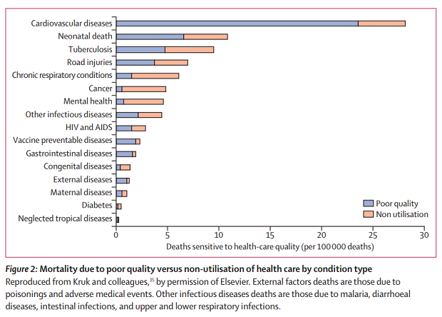
According to “LANCET GLOBAL HEALTH COMMISION” Almost 122 Indians per 1,00,000 die due to this type of sudden ill-health.

Slide 6
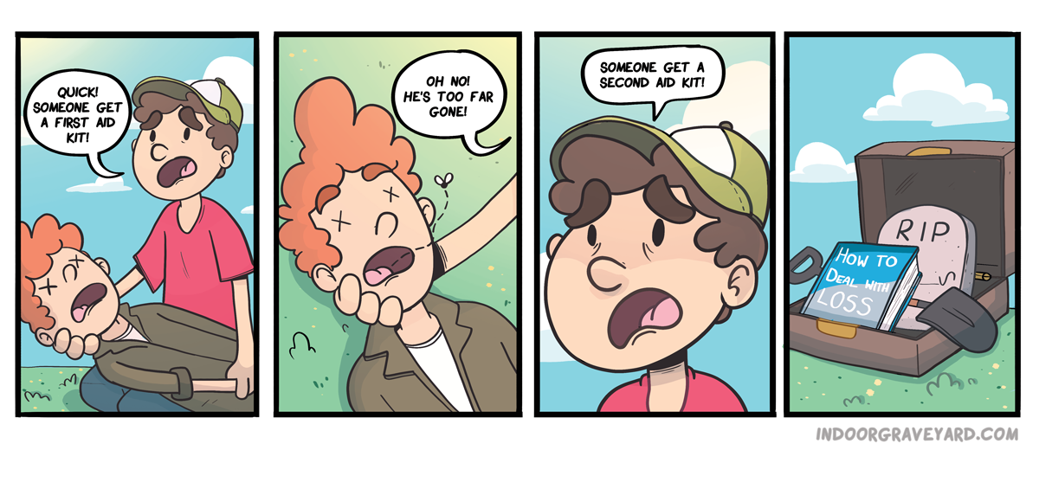
CAUSES FOR THIS TYPE OF ACCIDENTS AND ILL HEALTH
This type of Health factors are due to non-proper utilization of health care services and equipment.(ill-heath: small injuries, fainting, heat stroke, sudden arrest of heart, respiratory ,problems)
Causes for accidents in road is drunk and drive, over speed, carelessness, not obeying rules etc.

Slide 7
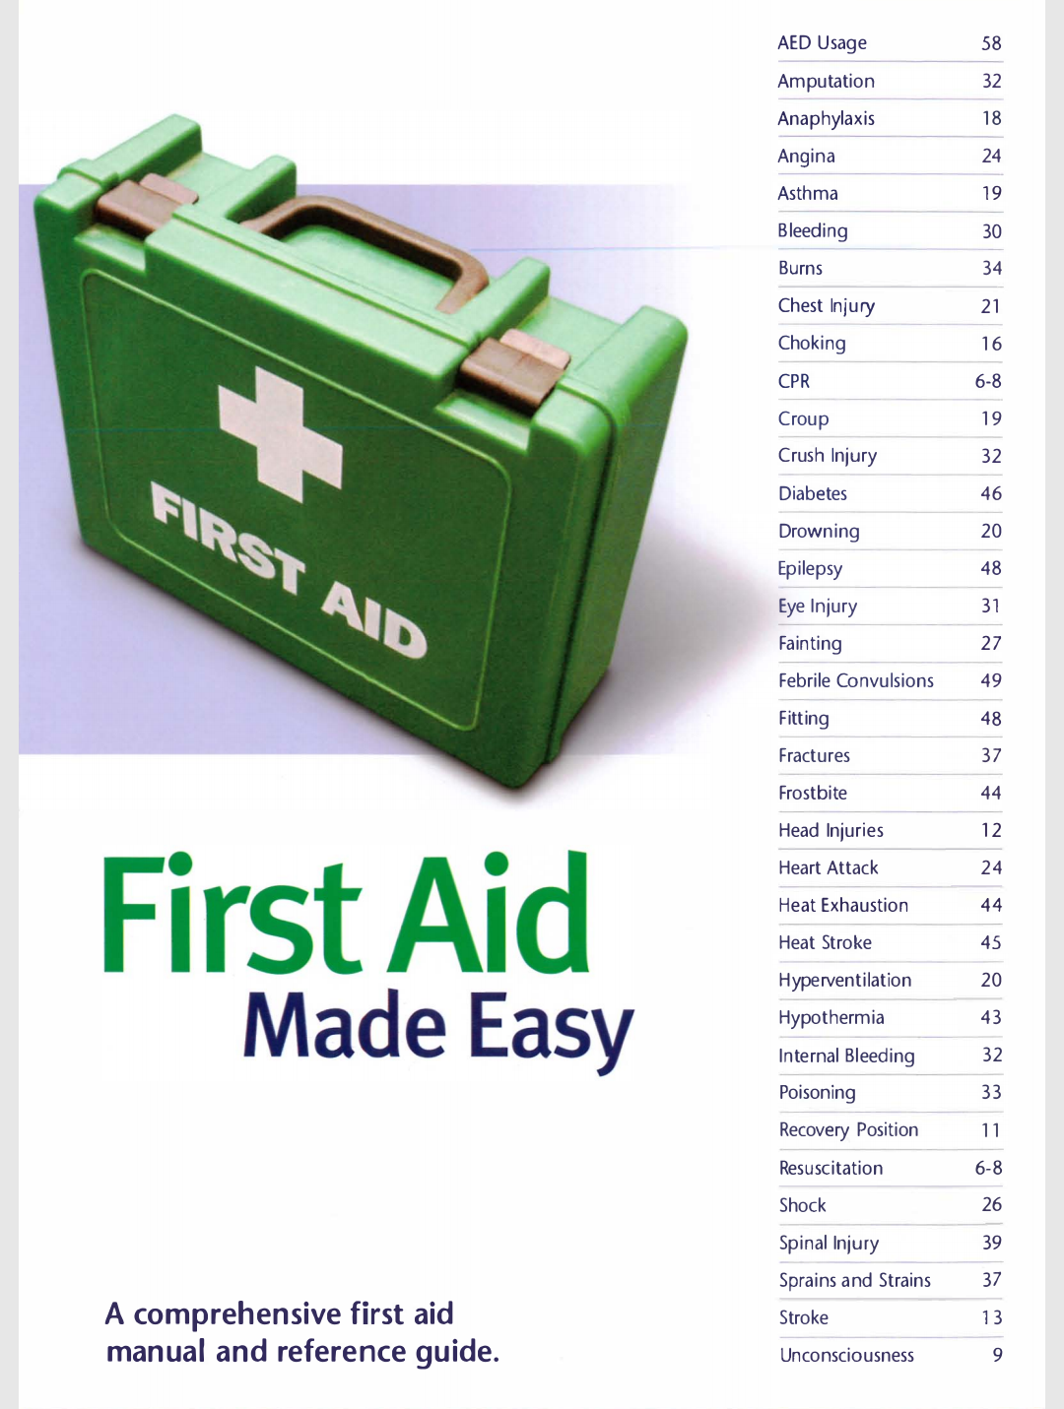
HEALTH PROBLEMS THAT CAN BE TREATED USING FIRST AID BOX

Slide 8
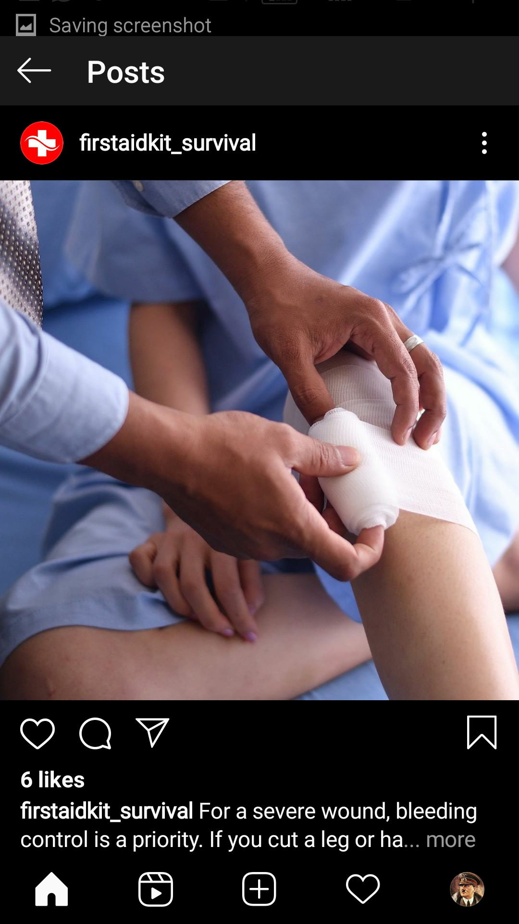
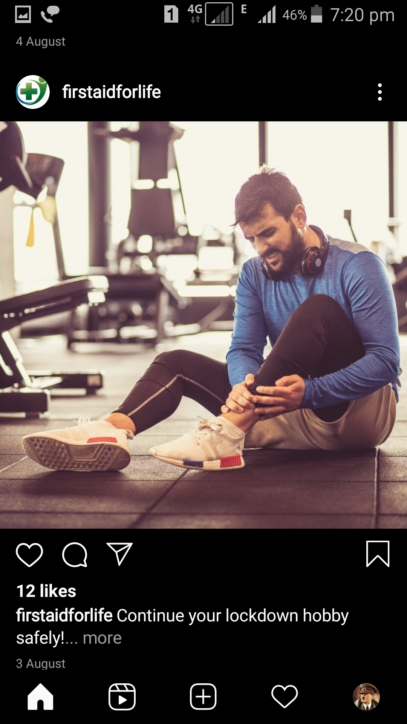
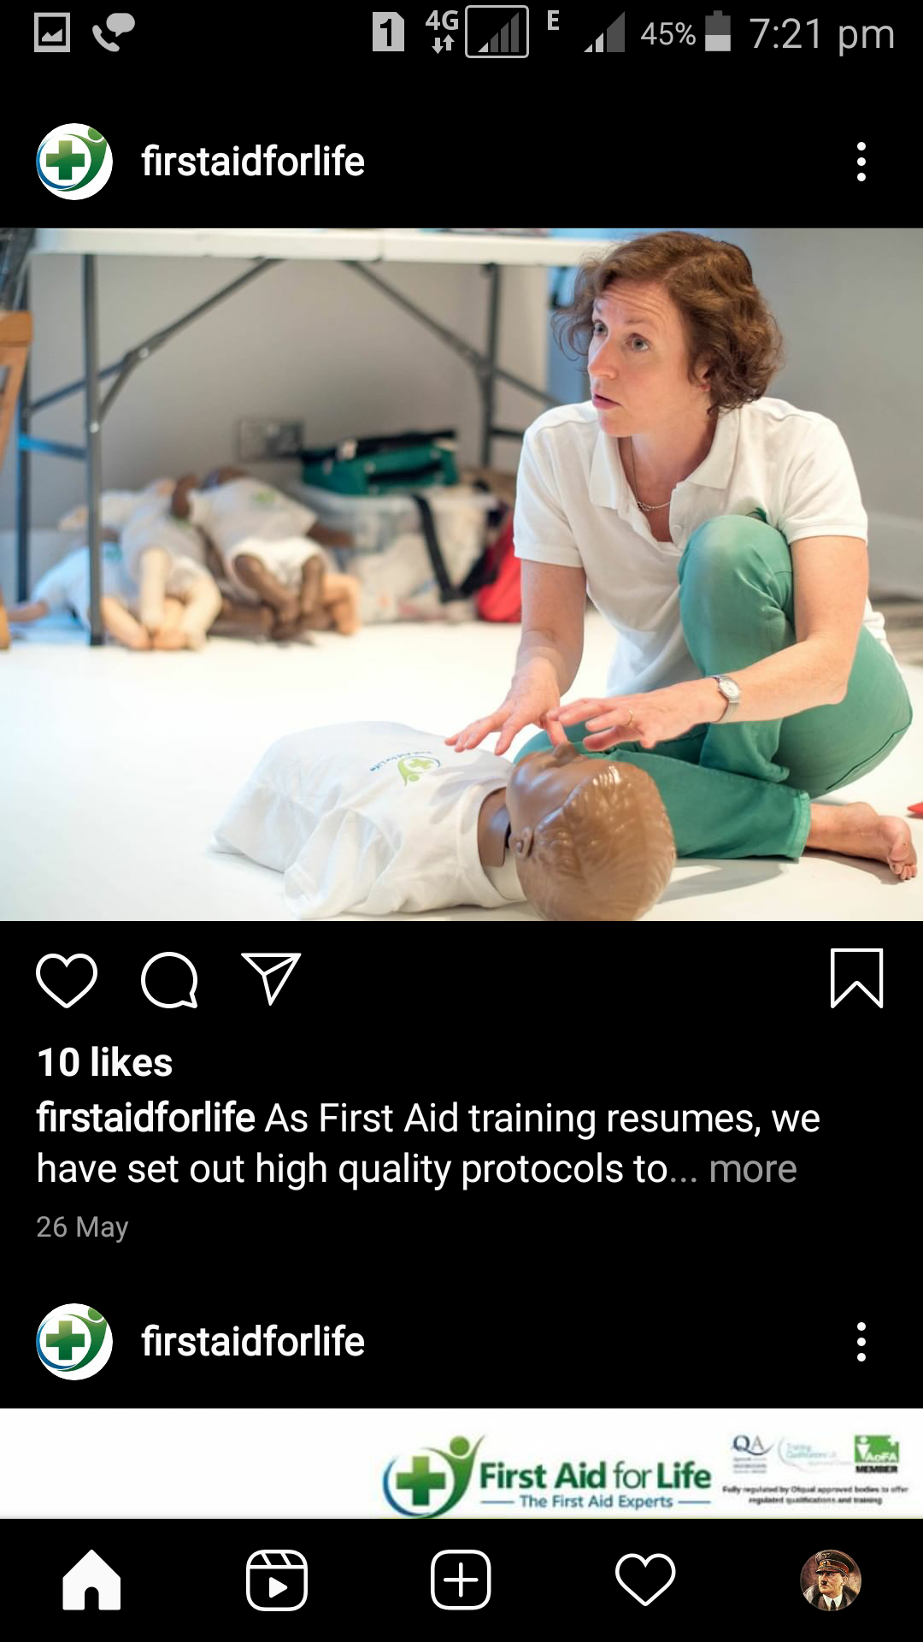
PRIORITIES OF FIRST AID
Preserve Life
Alleviate Suffering
Prevent The Condition From Worsening
Promote Recovery

Slide 9
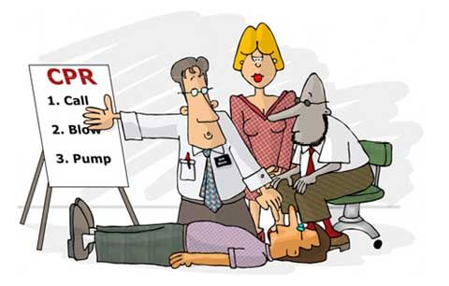
MEASURES FIRST AIDERS DO
Primary survey:
Dealing with casualty
Acronyms: D,R,A,B,C.
D = Danger
R = Response
A = Airway
B = Breathing
C = CPR

Slide 10

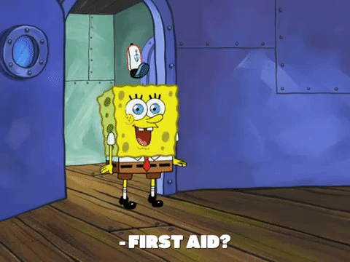
RESEARCH AIM
The research promotes the emergency medical kit facility for the common public, harmed by an unpleasant event. (illness or accident ) at FREE OF COST.
Towards this, the study proposes the constructive position of the kits based on the hot threat region.
Also, the study materialize the idea of the necessity and estimate of the basic and advance safety kit planted at proposed placed.
Layer, recommendation for training awareness for the usage of the kit, disposal of used component in the kit and its maintained

Slide 11
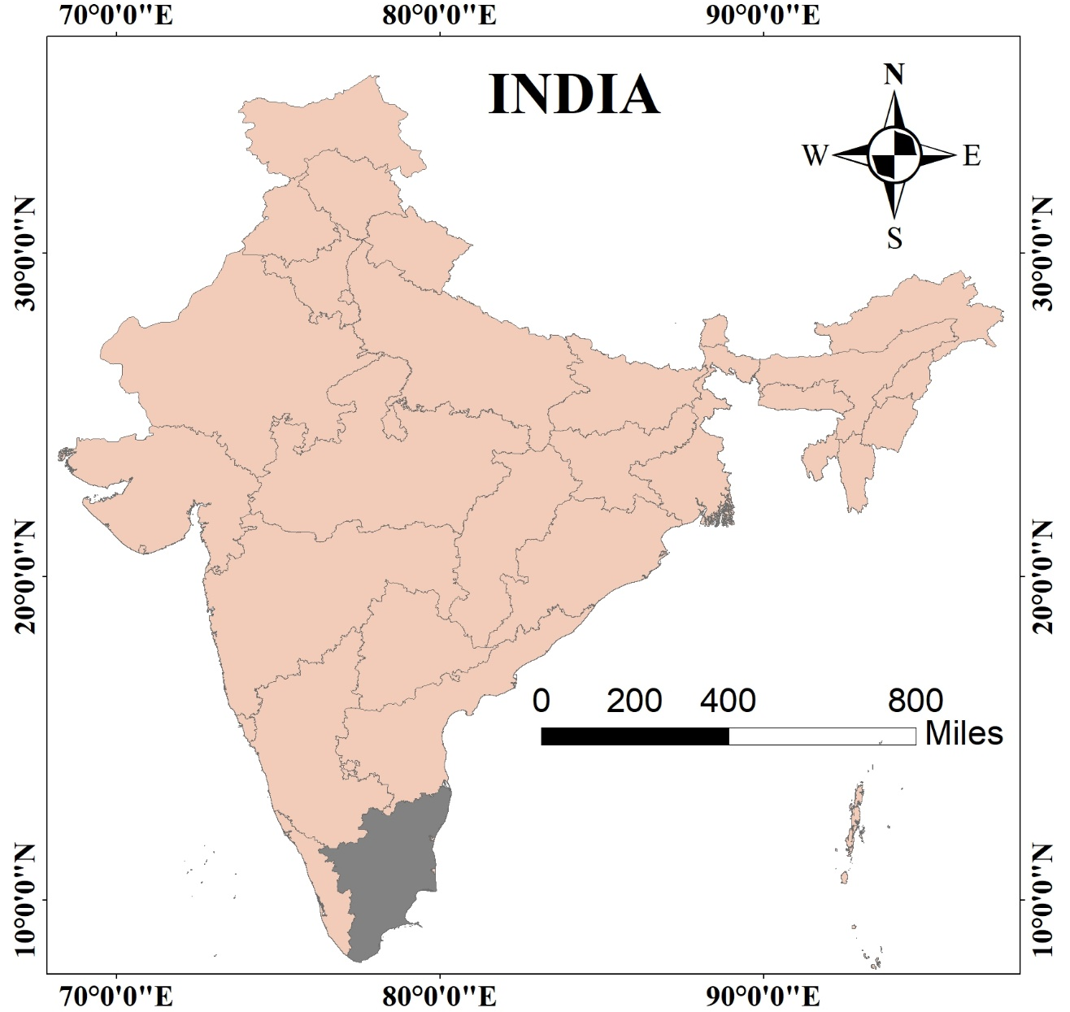

STUDY AREA

Slide 12
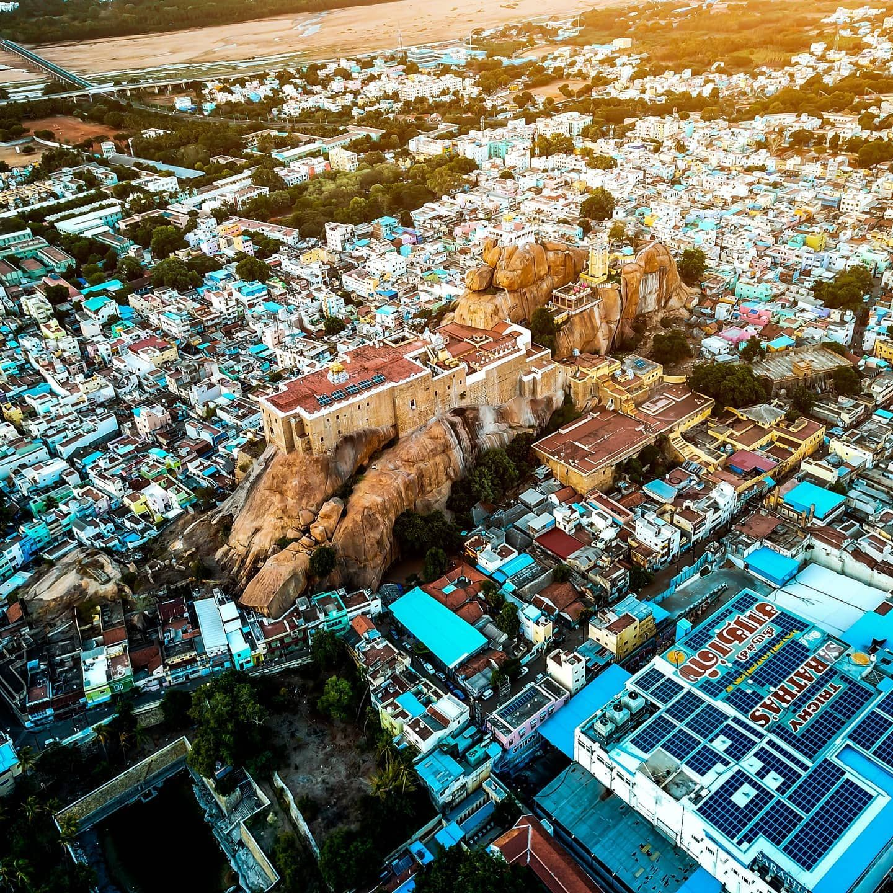
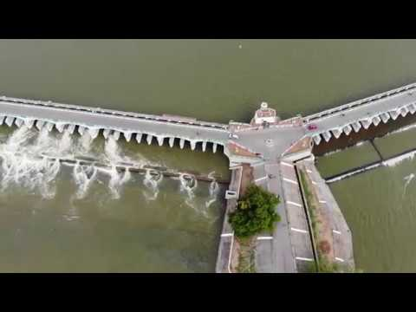
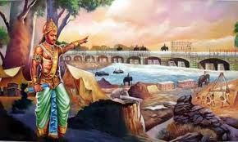
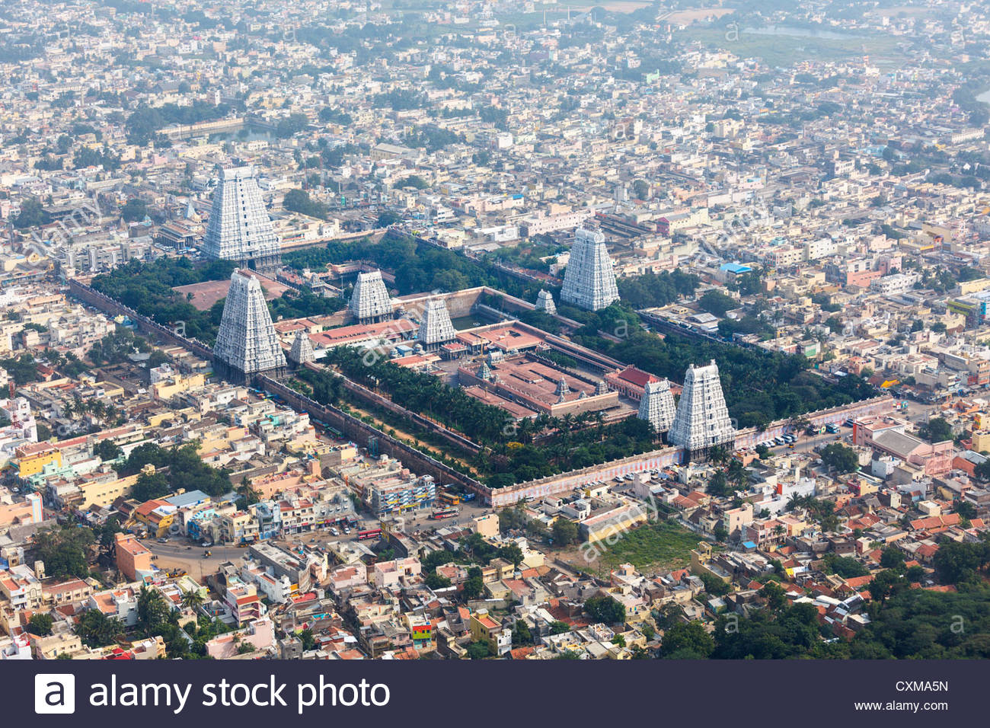
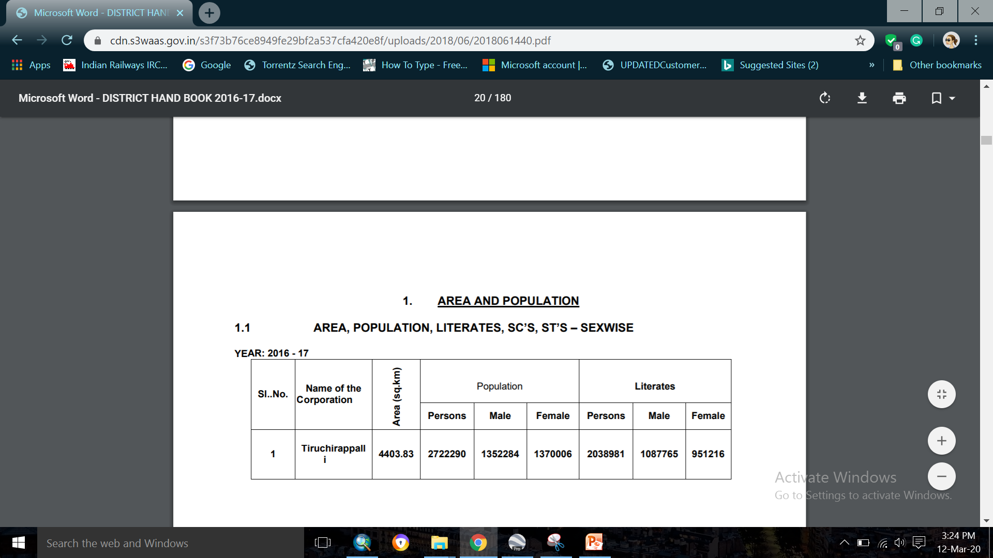
ABOUT TRICHY CITY CORPORATION
Tiruchirappalli district is located at the Central part of Tamil Nadu surrounded by Perambalur district in the north, Pudukottai district in the south, Karur and Dindigul districts in the west and Thanjavur district in the east. It lies between 10o10’ and 11o20’ of the Northern latitudes and 78o10’ and 79o 0' of Eastern latitudes in the center part of the Tamil Nadu.
The Cauvery Delta begins to form 16 kilometres (9.9 mi) west of the city where the river divides into two streams—the Kaveri and the Kollidam—to form the island of Srirangam
The region falls under Seismic Zone III, which is moderately vulnerable to earthquakes.
Tiruchirappalli is the only Municipal Corporation which is also the Head Quarters of the District. Densely populated industrial and residential areas have recently been built in the northern part of the city, and the southern edge also has residential areas. It is also one of the developing cities in India.It is well connected to national highways.
Climate: Tiruchirappalli experiences a dry-summer tropical savanna climate : with no major change in temperature between summer and winter. The climate is generally characterized by high temperature and low humidity. With an annual mean temperature of 28.9 °C (84.0 °F) and monthly average temperatures ranging between 25 °C (77 °F) and 32 °C (90 °F),the city is the hottest in the state
Year: (2017-2018)

Slide 13
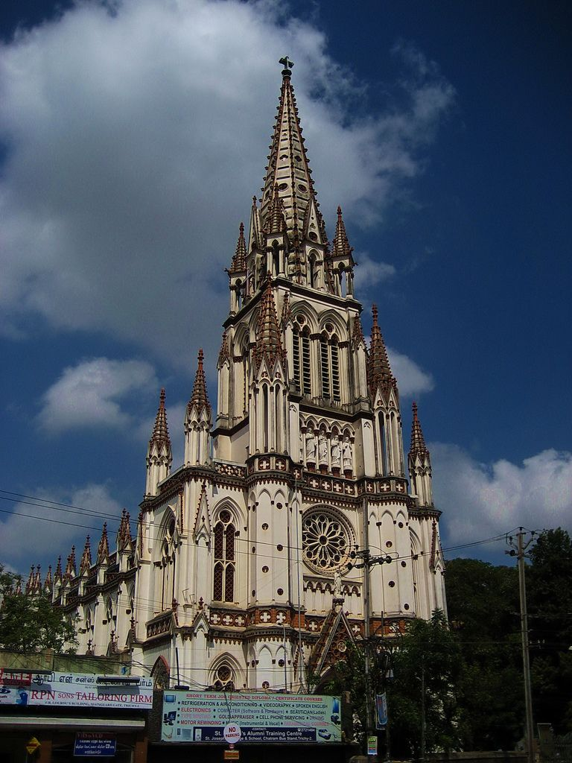
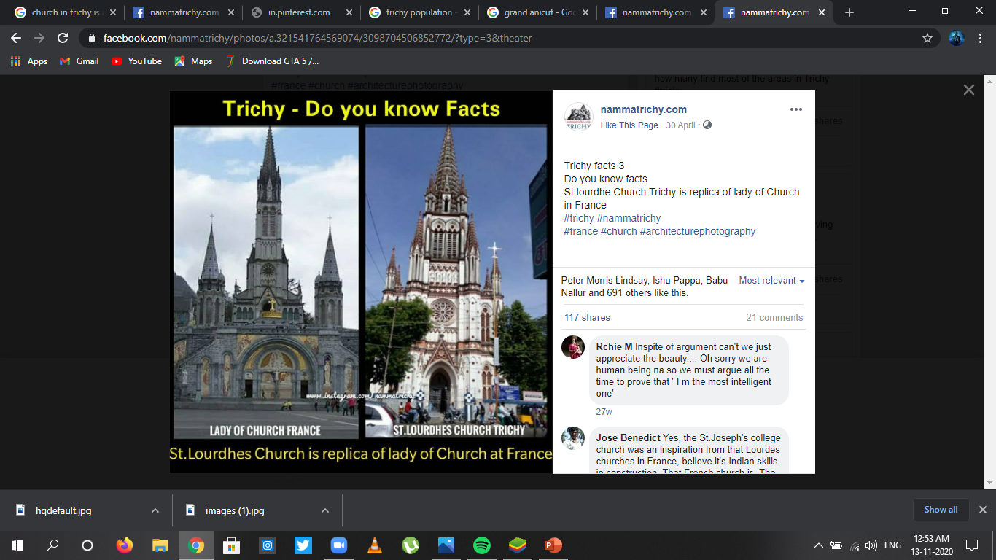

Slide 14
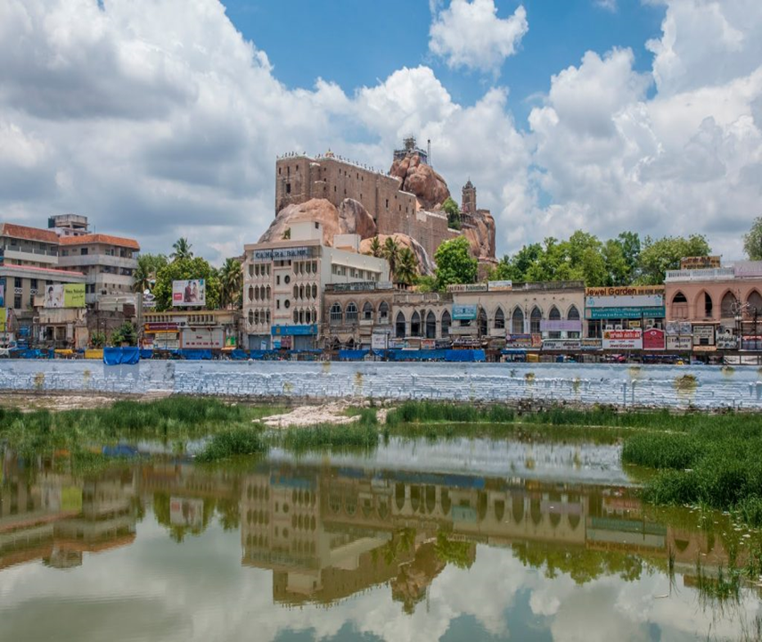
TRICHY FATALITY DATA
This is the fatalities due to accidents in Trichy.
Year 2019
YEAR | NO.OF.DEATH
JANUARY (2018) | 53
JANUARY (2019) | 29
2019 (MONTH) | NO.OF DEATH
JANUARY | 29
JUNE | 23

Slide 15
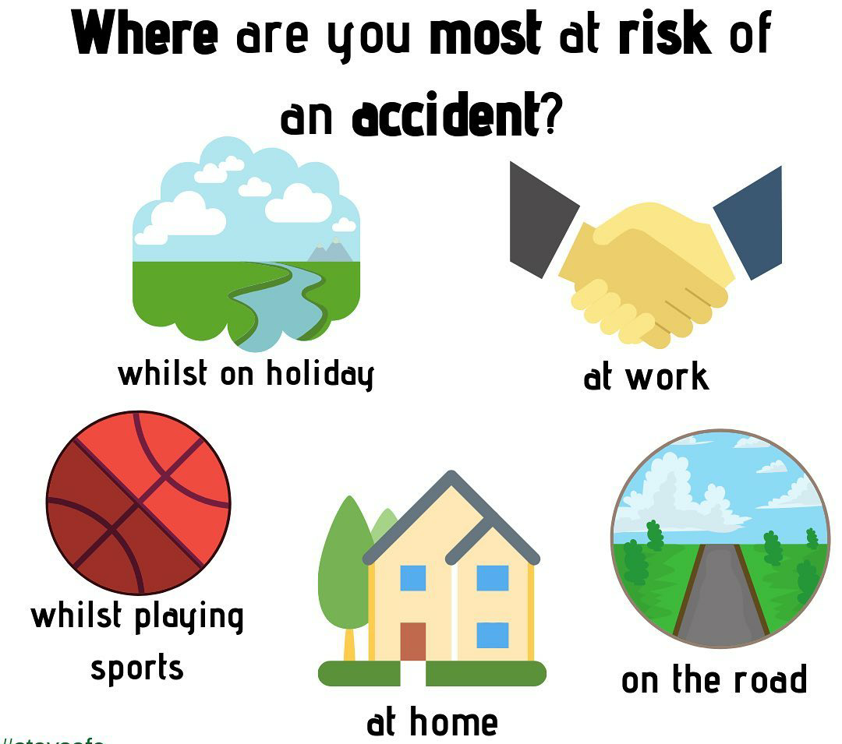
IDENTIFICATION CRITERIA (PARAMETERS)
The accident and hazardous area can be identified as location that have a higher expected number of incident and accident happened than the normal expected number.
Road junctions
Accident prone zones
Bus stands
Bazars/shopping malls
Educational institutions
Place of worship
Tourist spots
Railway stations
Cinema theaters
Airports
Play grounds

Slide 16
PLANNING PROCESS
METHODOLOGY
Education Institution
Shopping zones
Bus stop
BUFFER,UNION &INTEGRATE
TOPOSHEET AND OPEN BING MAPS
GIS ANALYSIS
Government
offices
Signal
Place of worship & Tourist spot

Slide 17
MODELLING AND PROJECTION

Slide 18
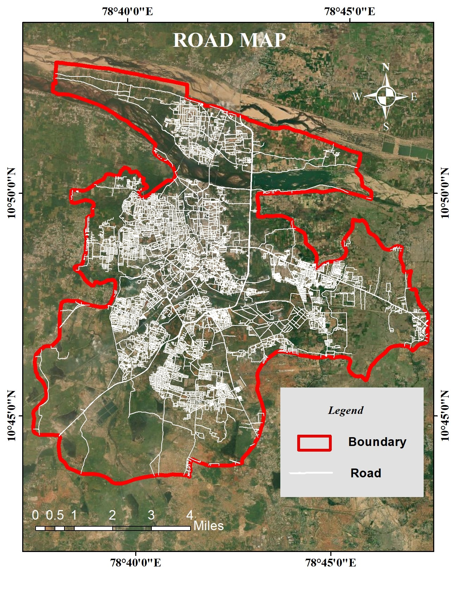
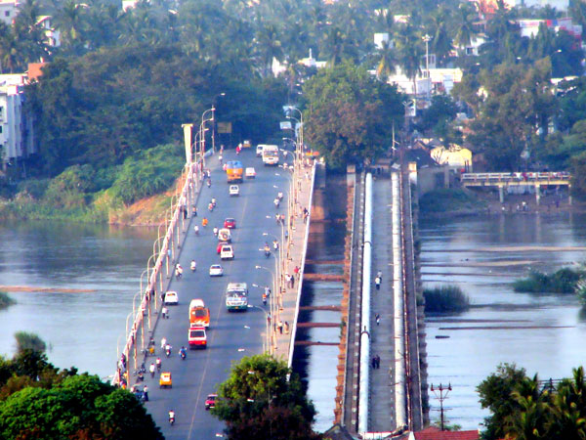

Slide 19
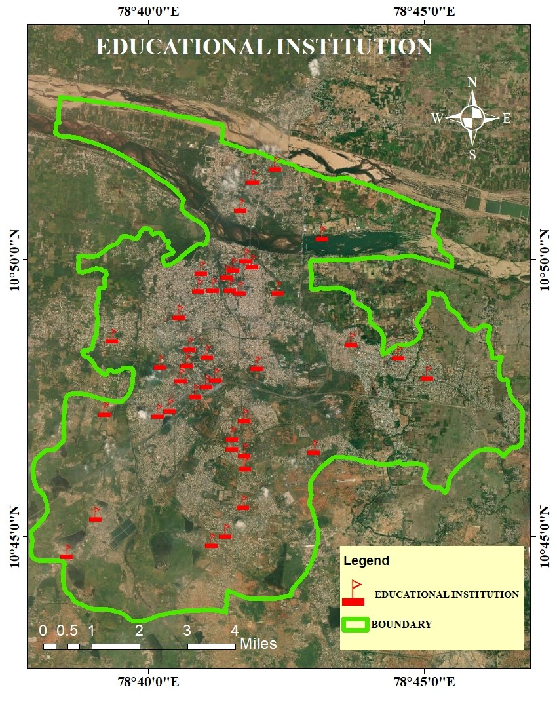
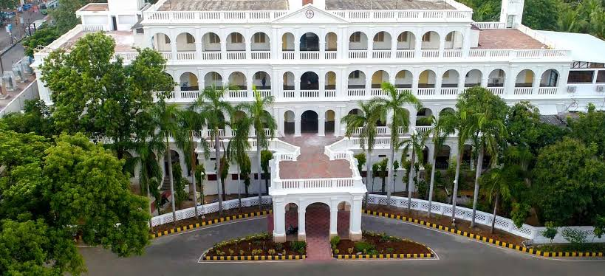
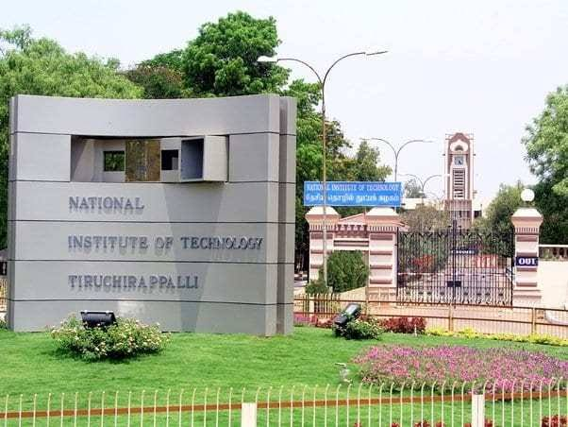

Slide 20
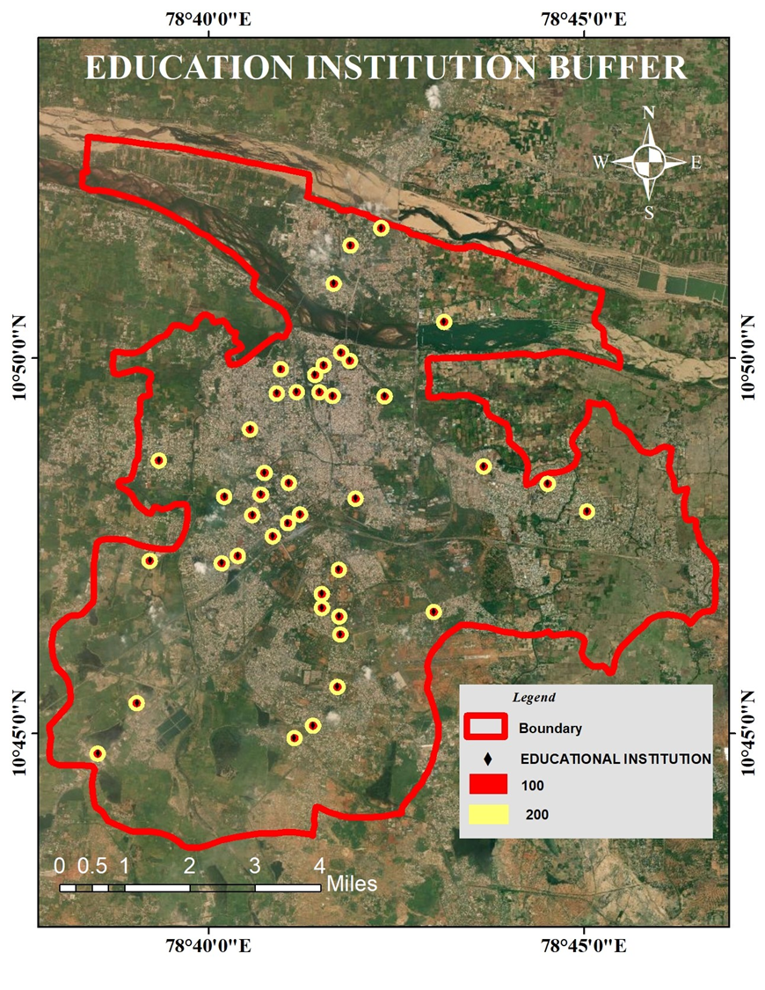
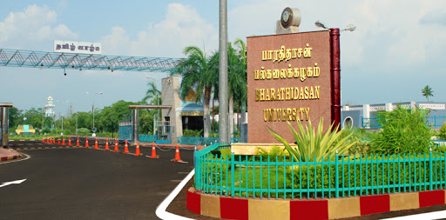

Slide 21
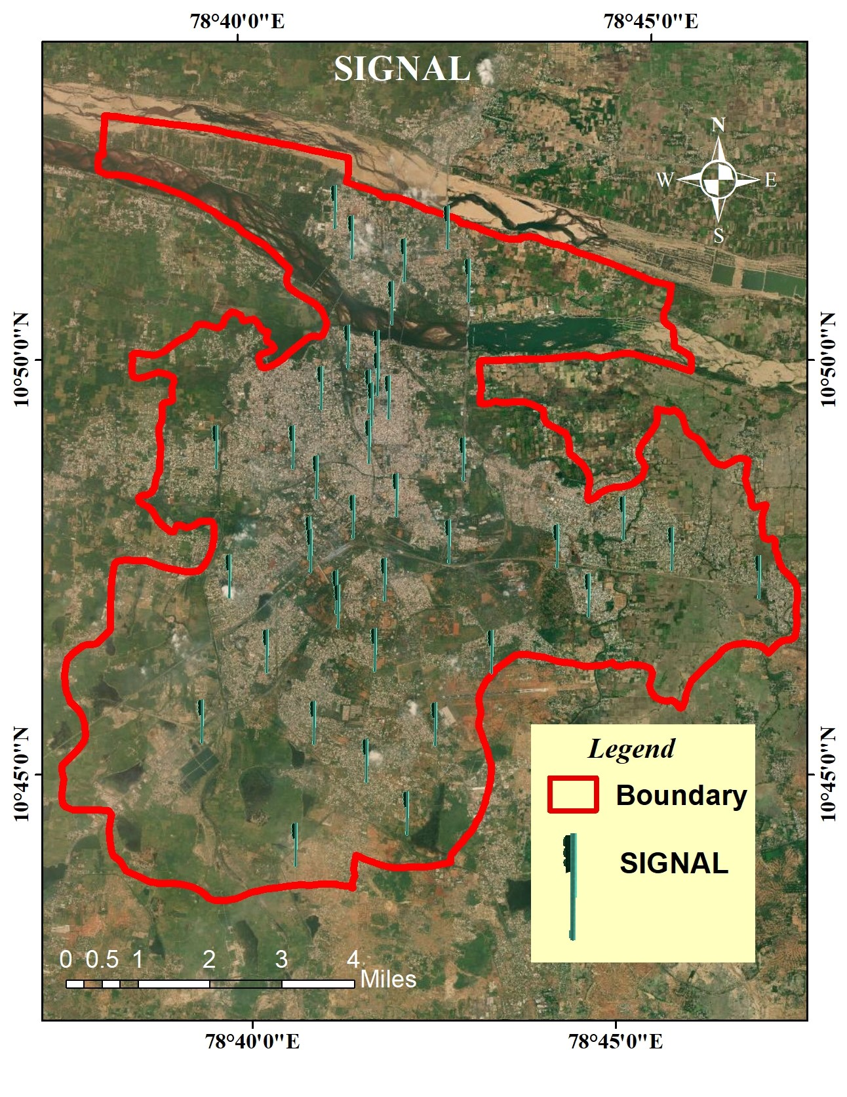
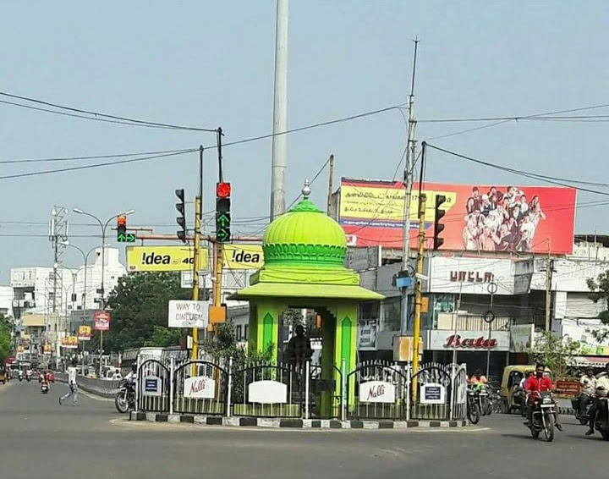

Slide 22
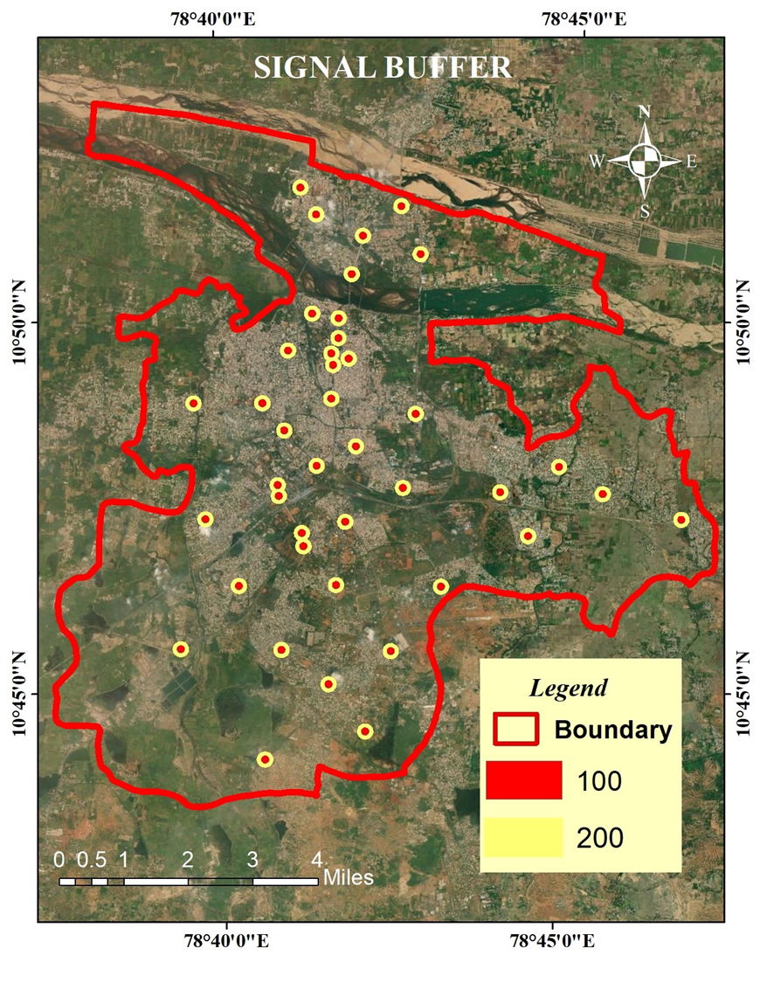
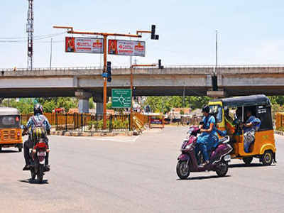
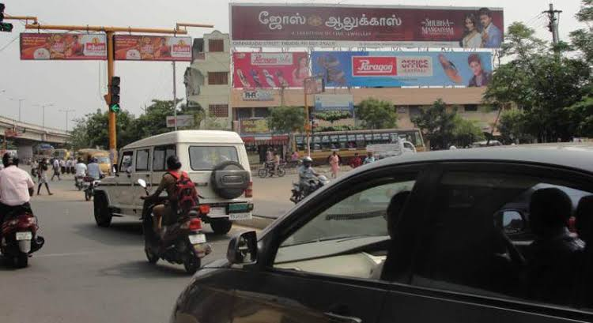

Slide 23
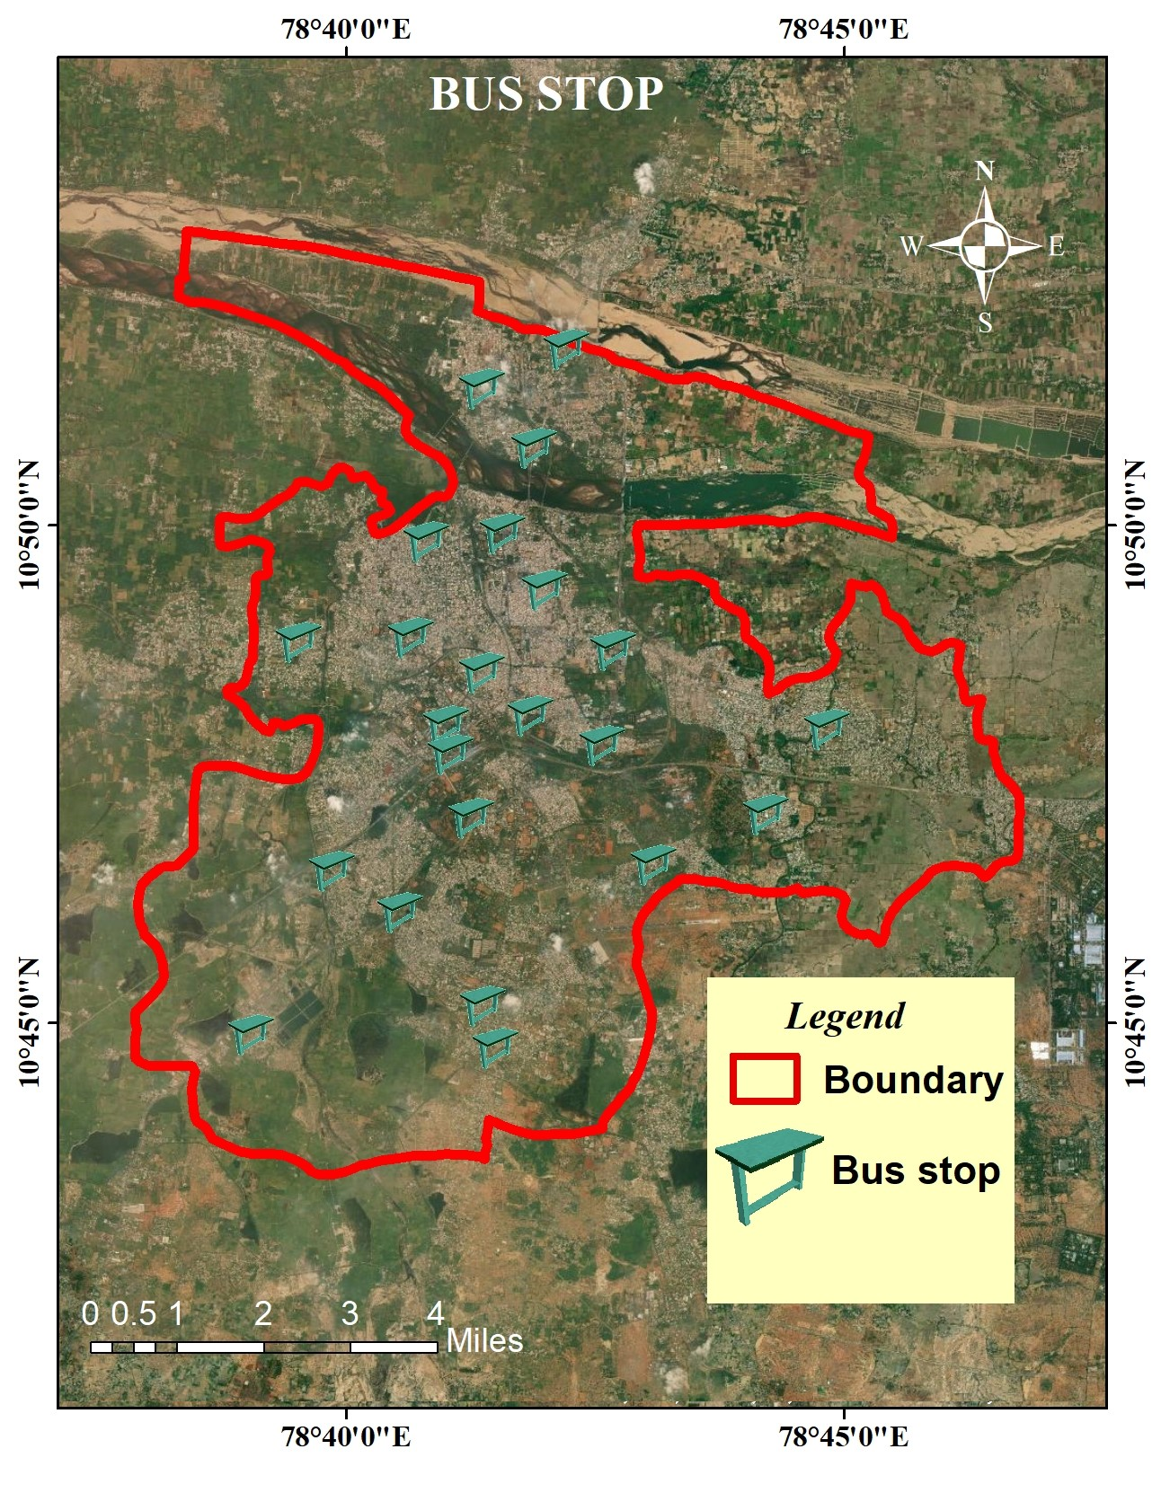
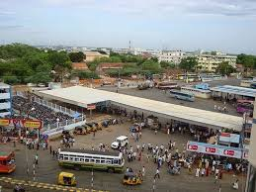

Slide 24
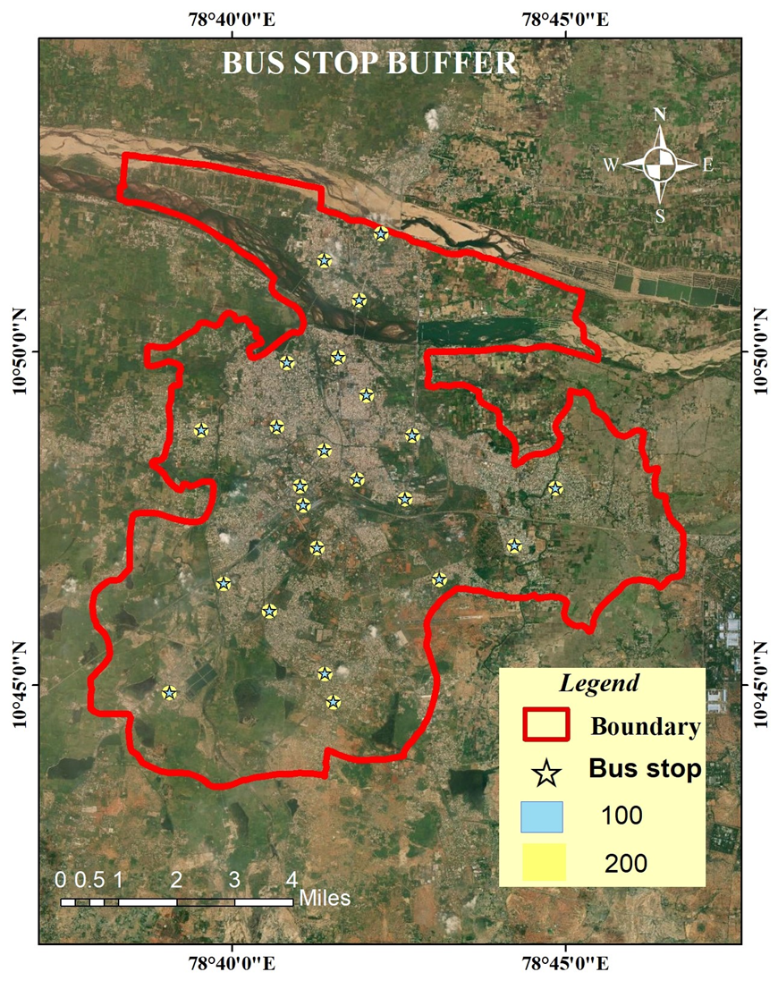
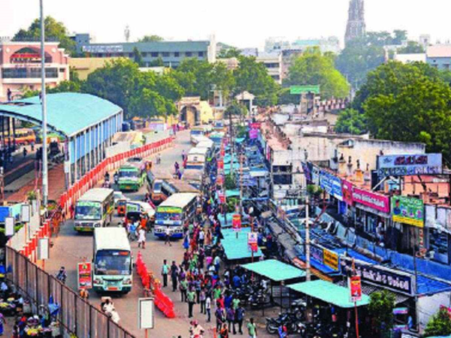

Slide 25
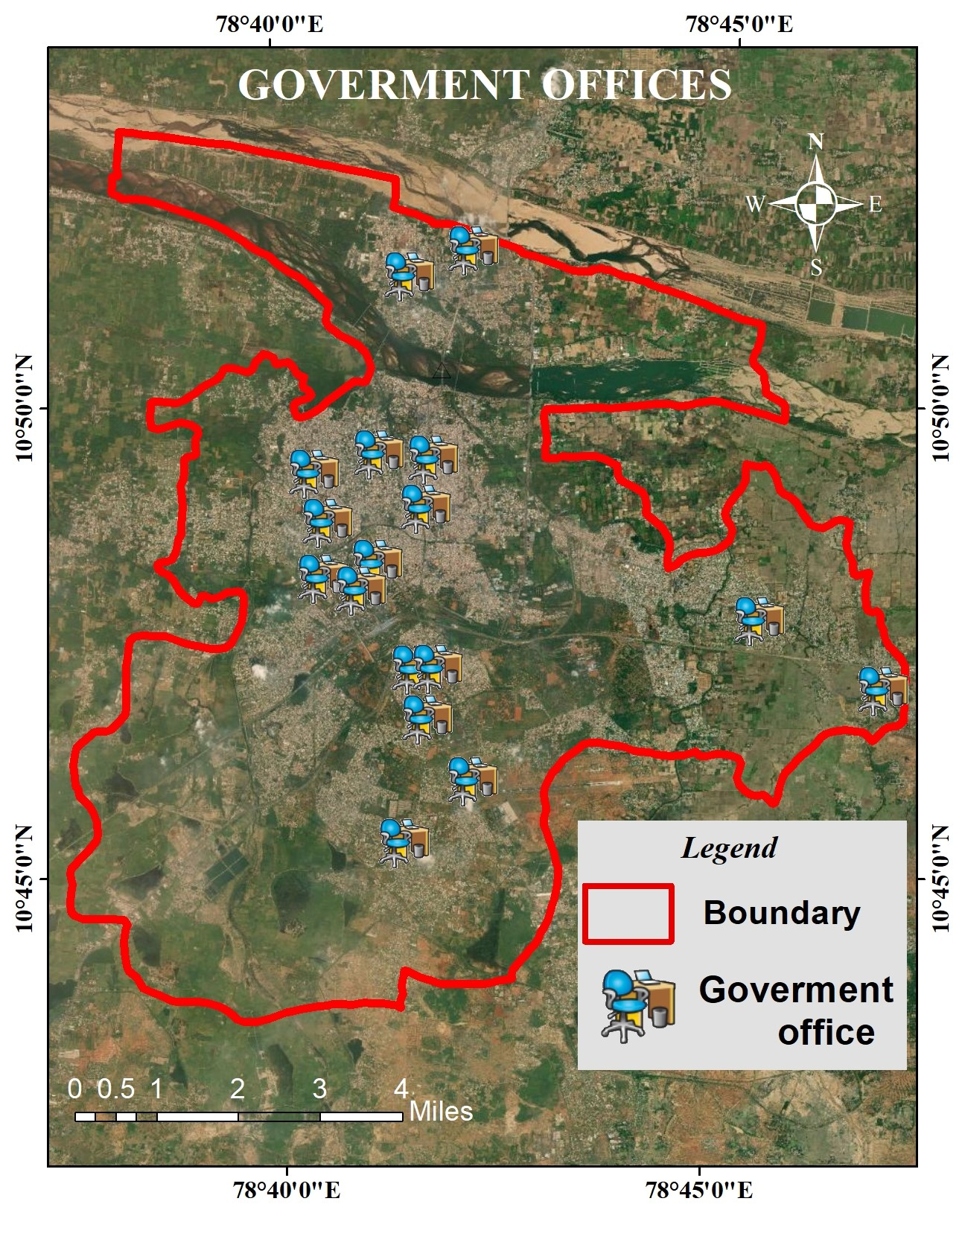
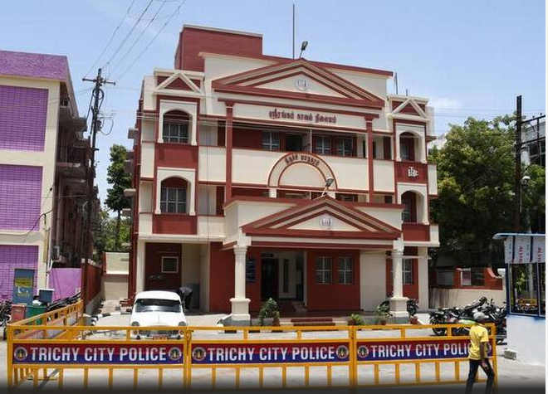

Slide 26
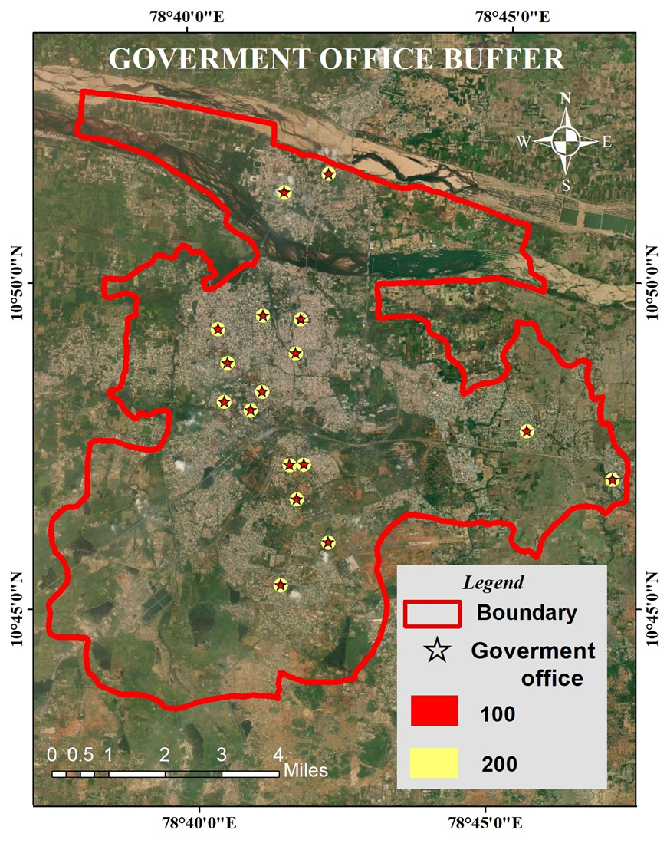
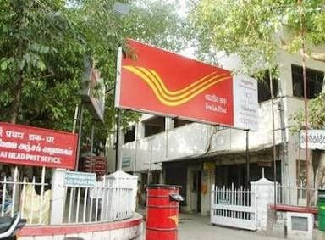
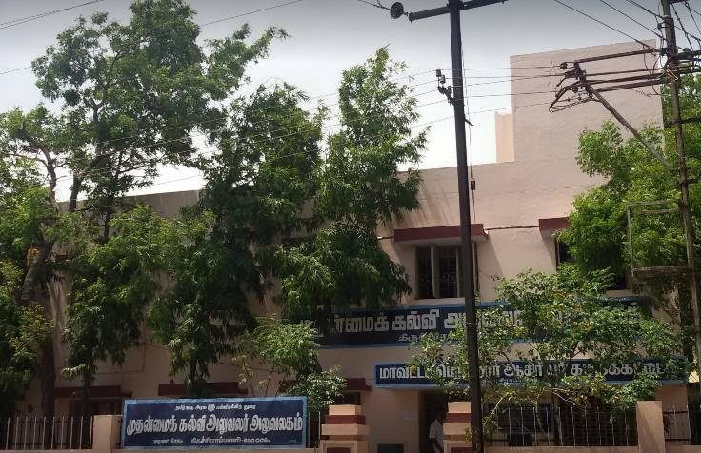

Slide 27
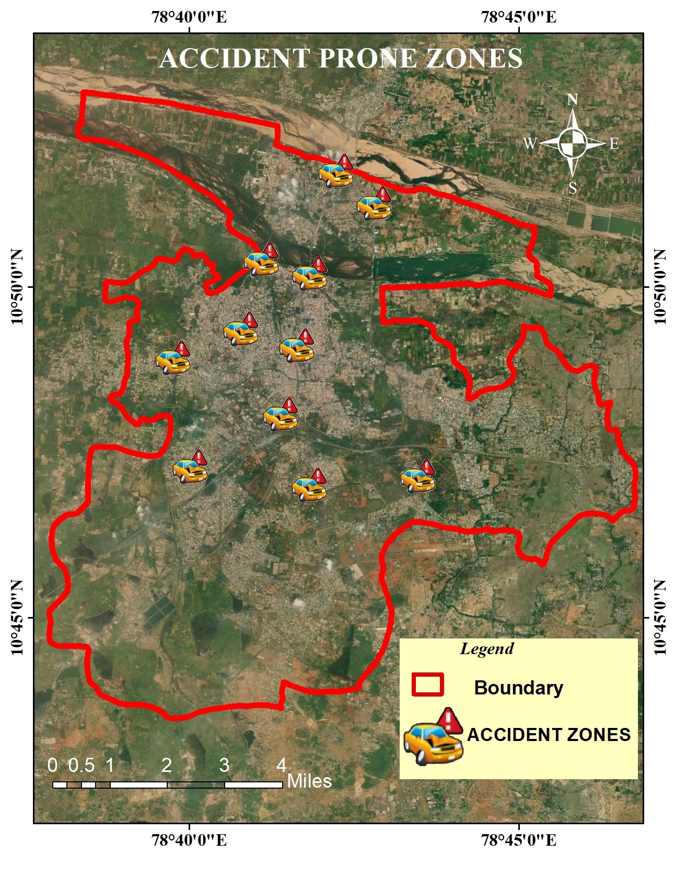


Slide 28
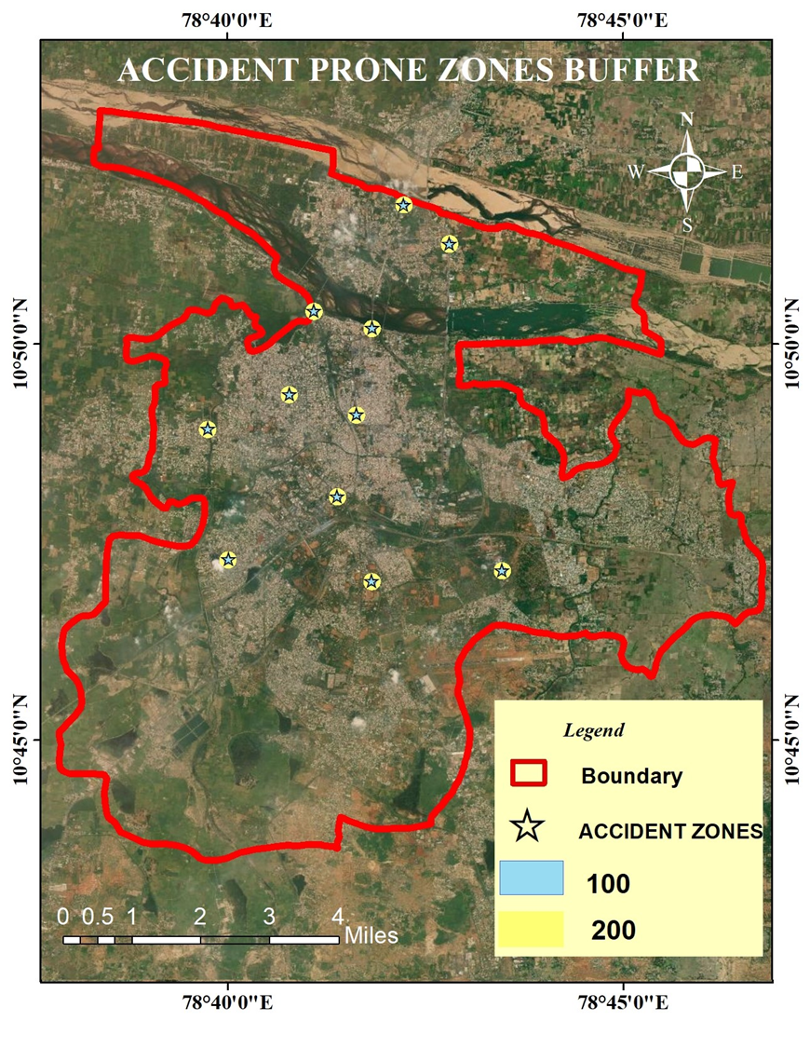
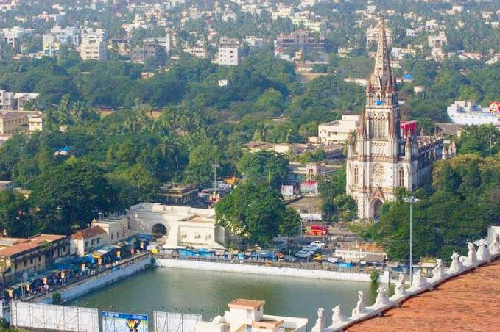

Slide 29
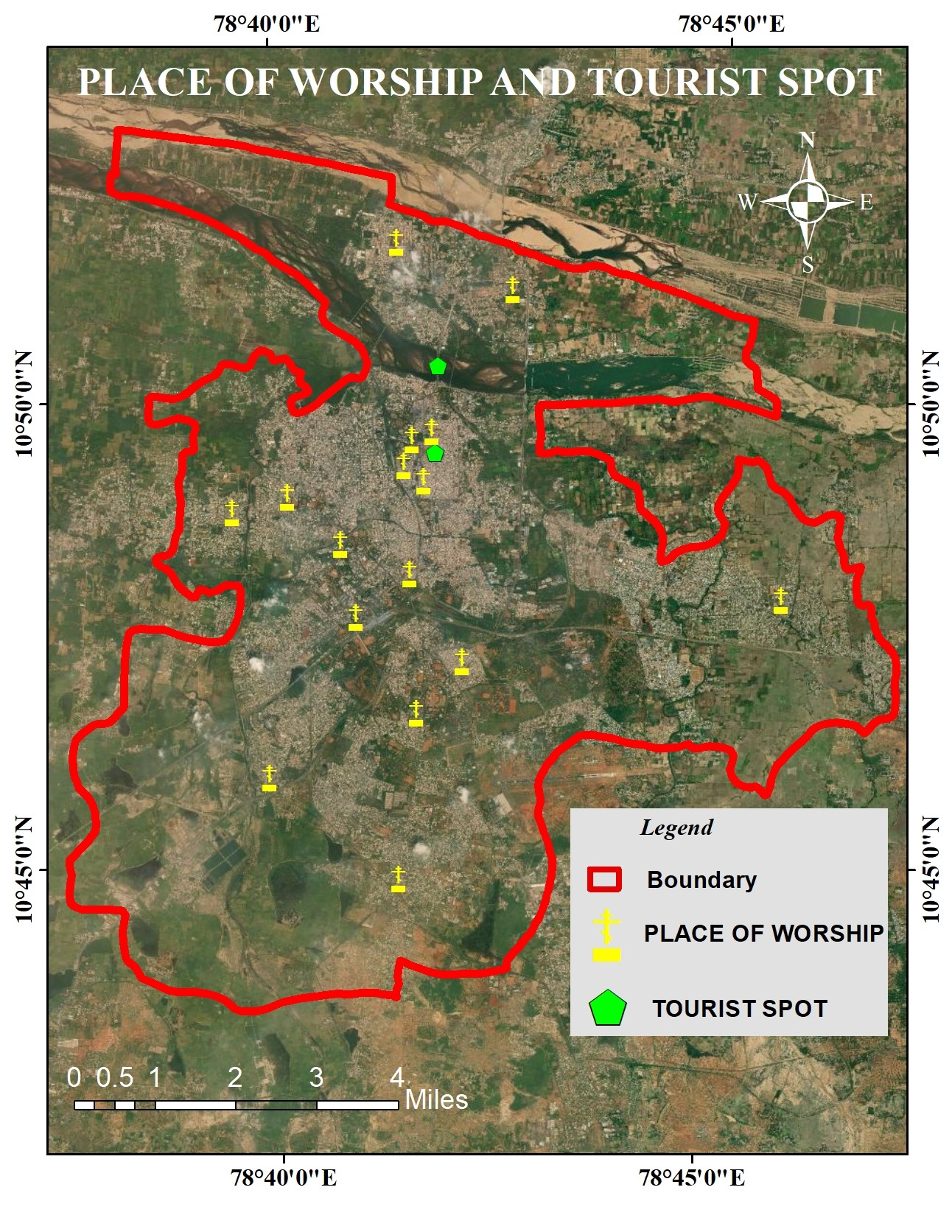

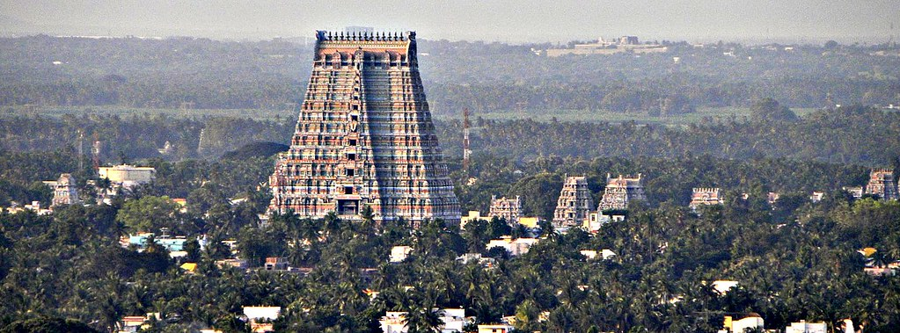

Slide 30
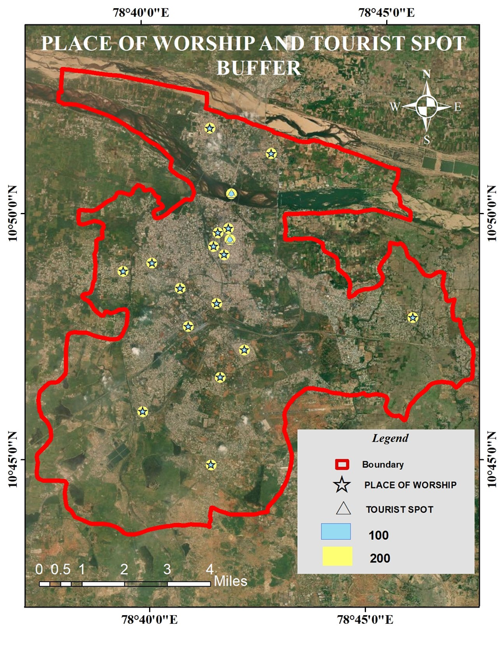
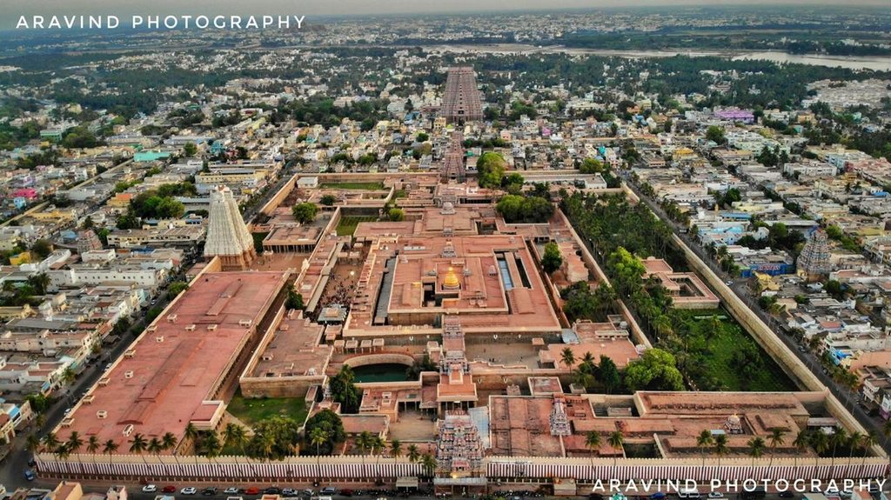

Slide 31
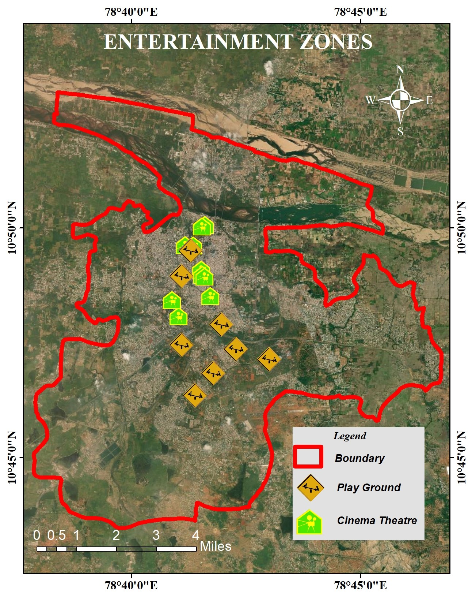



Slide 32




Slide 33




Slide 34




Slide 35



Slide 36



Slide 37



Slide 38


SUITABLE SITE FOR FIRST AID BOX
The suitable site for installing first aid box in Trichy are
SRIRANGAM
THIRUVANAIKOVIL
PERIYAR NAGAR
MAMBALASALAI
RAJA COLONY
WORAIYUR
CHATHRAM
ANAMALAI NAGAR
SINGARATHOPPU
UYAKONDANTHIRUMALAI
KATTUR
MELAPUTHUR
JUNCTION
IOB NAGAR
KAJAMALAI
EDAMALAIPATIPUTHUR
KK NAGAR
ANAND NAGAR

Slide 39

EMERGENCY ACTION STEP
CHECK
CALL
CARE
WHEN TO CALL AMBULANCE

Slide 40

ROLE OF FIRST AID BOX IN EMERGENCY SITUATION
Oct 9, 2020
A massive fire has engulfed a 33-storey tower block in South Korea. Video footage showed the blaze spreading across all of the Samhwan Art Nouveau commercial and residential building in the city of Ulsan, reports the BBC. Debris fell to the ground as the huge fire spread.
Hundreds of people were evacuated, including from the roof, the Yonhap news agency said, with many suffering smoke inhalation.
The fire broke out between the eighth and 12th floors of the building, which has about 120 households and shopping units.
Some 77 people had been treated for smoke inhalation, the fire department said.

Slide 41


PLAN IMPLEMENTATION
First aid box is setup in the above proposed areas.
A camera and sensor is fixed in the first aid box which will start capture when someone open the box .so that the officials can see what’s happening in the incident place and intimation will be send to the control room and ambulance when someone opens the advanced equipment section.

Slide 42

FIRST AID BOX MODELS

Slide 43






Slide 44



Slide 45



In future the first aid box may be added to the categories in navigation map and GPS map which will show the place of first aid box .
A sign board will be placed to show the direction and distance of the first aid box.
The trashed, used medicated materials in the dustbin(placed below the first aid box) will be collected by the sanitary workers.

Slide 46




Training awareness to people like hospital sub staffs, health department workers, police department, teachers, students in schools and colleges via organizations (red cross, scout, NCC, NSS ) for better emergency treatment (on spot) and also through television can spread awarness

Slide 47


MAINTANANCE
The maintenance of kit and its components should be maintained by the sanitary workers, corporation staffs or primary health center workers.
The materials and equipment's are supplied by the GOVERNMENT HOSPITALS
Refilling the material is done at once after using the materials according to the usage by surveillance via camera.

Slide 48

ESSENTIAL MATERIAL IN FIRST AID BOX
Sanitizer
Adhesive
Sterile gauze pads
Roller Bandage
Adhesive Tape
Mouth Barrier Device
Moleskin
Scissors
Tweezers
Splints
Space blanket
Eye wash
Sunburn lotion
Antiseptic
Burn dressing and Gel
Benadryl
Imodium
Antibiotic
Pain reliever
Butterfly closure strips
Aspirin
Cotton
Tweezers and Magnifying Glass
Calamine lotion

Slide 49





Slide 50
COST ESTIMATION
Materials in first aid box = USD $ 16 /set(approx.)
Small first aid box = USD $ 20 /set(approx.)
Dustbin = USD $ 6 /set(approx.)
Sign board = USD $ 10/set(approx.)
Camera and sensor = USD $ 30/set(approx.)
(FOR A SINGLE FIRST AID = USD $82/set(approx.)
SETUP)
First aid box may vary according to places viz. box size , set of material placing, no of sign boards and necessity of automated first aid equipment's the cost may vary .The above given calculation is for doing manual help and for small injuries.

Slide 51
ADVANCED EQUIPMENT
A Full ADVANCED EQUIPED materials that Includes
Automated CPR kit = USD $ 220/set(approx.)
SURGICAL STAPLER = USD $ 20/set(approx.)
OXYGEN CYLINDER = USD $ 24/set(approx.)
NEBULIZER = USD $ 13/set(approx.)
(cost of advanced = USD $ 277/set(approx.)
materials alone )

Slide 52



Slide 53




Slide 54

Conclusion
On this analysis have found 100 suitable sites were selected for installing the first aid box in Tiruchirappalli corporation.
By installing first aid box reduce the fatality rate
We are planning to install a test model first aid box in Bharathidasan University at khajamalai campus.

Slide 55
A TIMELY HELP
SAVES A LIFE

